Slide 1
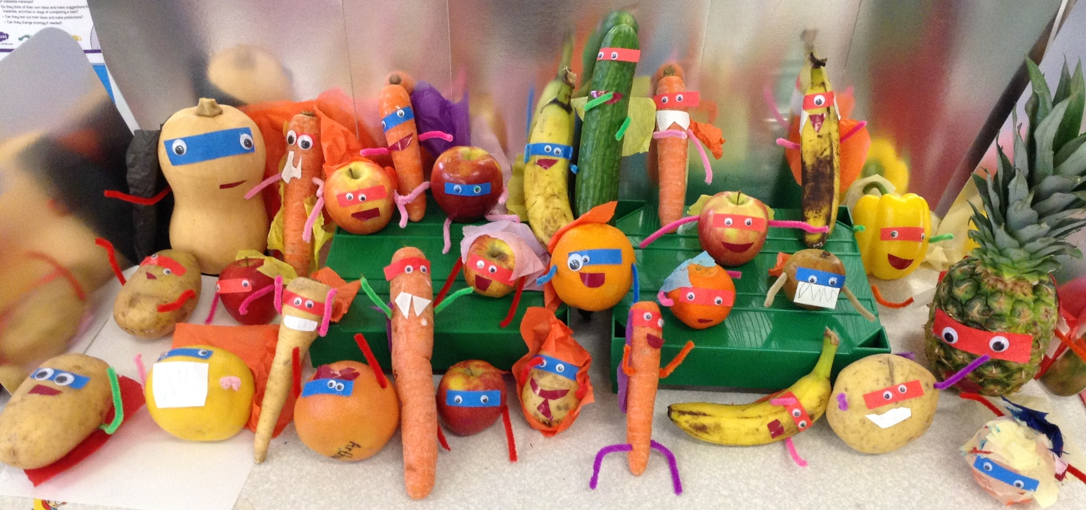
Super Vegetables
by Willow Class

Slide 2
Aidan’s Super Potato

Slide 3
Aoife’s Super Grapefruit

Slide 4
Arla’s Super Apple

Slide 5
Arthur’s Super Grapefruit

Slide 6
Ben’s Super Banana

Slide 7
Charles’ Super Pineapple

Slide 8
Chloe’s Super Carrot

Slide 9
Erin’s Super Banana

Slide 10
Esme’s Super Apple

Slide 11
Esther’s Super Potato

Slide 12
Faris’ Super Potato

Slide 13
Finn’s Super Carrot

Slide 14
Fintan’s Super Orange

Slide 15
Florence’s Super Parsnip

Slide 16
Fred’s Supertato

Slide 17
Freya F’s Super Banana

Slide 18
Freya J’s Super Apple

Slide 19
Gabe’s Super Apple

Slide 20
Isaac’s Super Cucumber

Slide 21
Jack’s Super Apple

Slide 22
James’ Super Carrot

Slide 23
Leonidas’ Super Orange

Slide 24
Luke’s Super Apple

Slide 25
Martha’s Super Carrot

Slide 26
Mia’s Super Carrot

Slide 27
Olivia’s Super Apple

Slide 28
Oscar’s Super Apple

Slide 29
Stephen’s Super Squash

Slide 30
Zac S’ Super Pepper

